Slide 1

Quantum Resources in Harrow-Hassidim-Lloyd Algorithm Pradeep Kumar, Tanoy Kanti Konar, Leela Ganesh Chandra Lakkaraju and Aditi Sen(De)
arXiv:2308.04021v1 [quant-ph] 8 Aug 2023

Slide 2
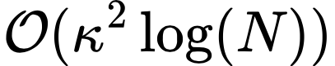
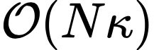
Quantum
Classical
The algorithm

Slide 3
The algorithm

Slide 4
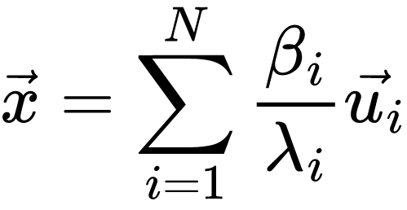
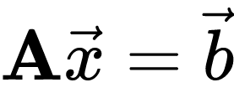
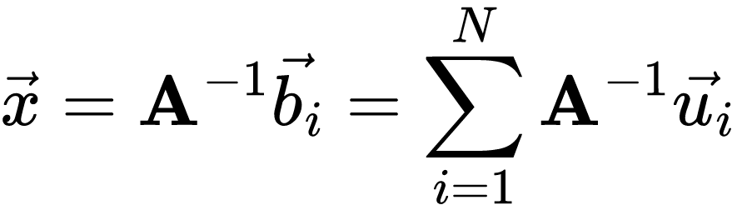
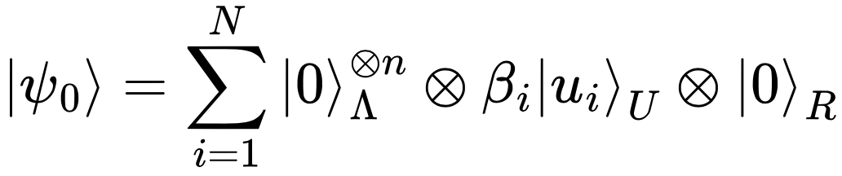
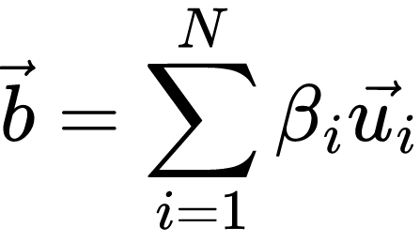
What we need ?

Slide 5

What we need ?

Slide 6

What we need ?

Slide 7
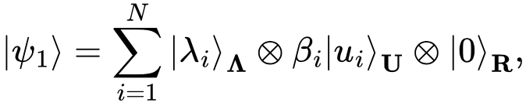
How does HHL algorithm achieve it ?

Slide 8

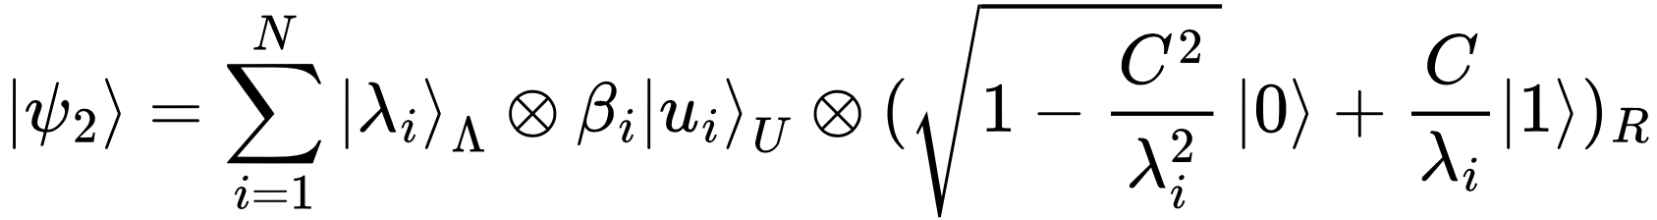
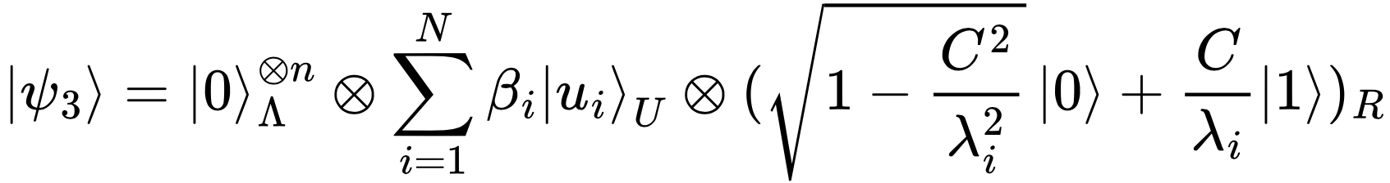
HHL Algorithm

Slide 9
HHL Algorithm

Slide 10
The algorithm

Slide 11
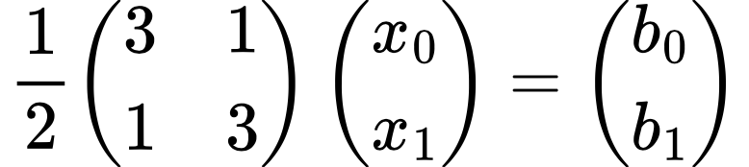

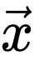
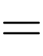
Quantum Advantage

Slide 12
Quantum Advantage

Slide 13


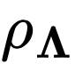
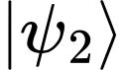
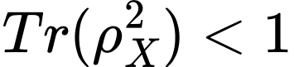
Nonvanishing genuine multipartite entanglement
Theorem -1
For a successful run of the HHL algorithm, genuine multipartite entanglement should be nonvanishing in the second step
We prove that all the single-site local density matrices, , and of the state are mixed i.e.
Since the total state is pure, mixed local density matrices ensure that no biparition is product, thereby proving nonvanishing GME of

Slide 14
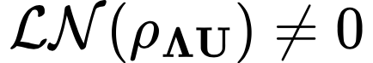
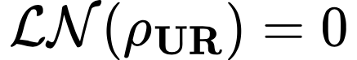
Bipartite entanglement between Λ and U is nonvanishing
Theorem -2
Unlike GME, bipartite entanglement between subsystems are always present in different stages of the algorithm

Slide 15
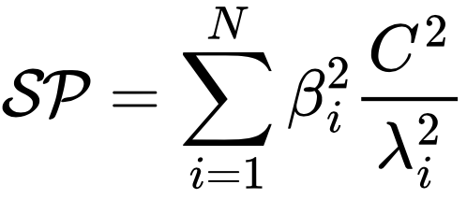
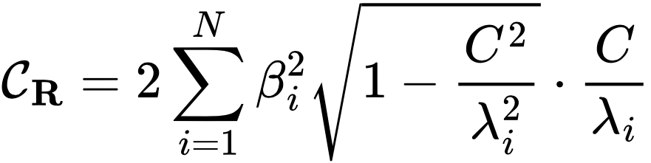
The l1-norm coherences are non-vanishing
Proposition -1
In computational basis C_{R}, C_{U}, and C_{ΛUR} are non vanishing
C_{Λ} is zero as is diagonal in computation basis
Remark : We found that C_{R} is closely related to Success Probability

Slide 16
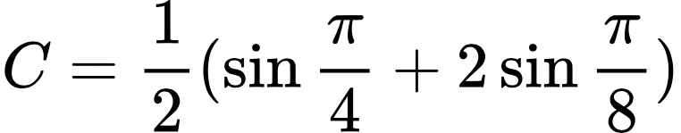
Quantum Advantage

Slide 17
Quantum Advantage

Slide 18
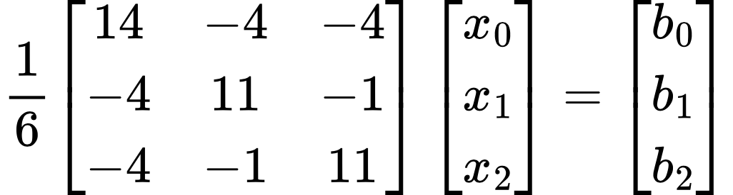
Quantum Advantage in 3D

Slide 19
Quantum Advantage in 3D

Slide 20
Success Probability

Slide 22

Success Probability

Slide 23
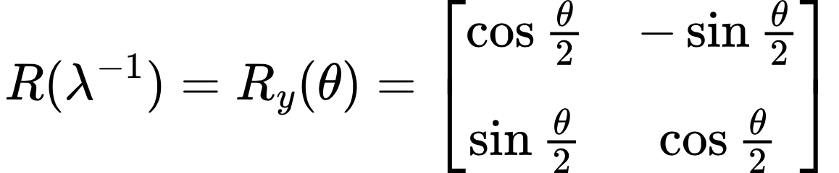
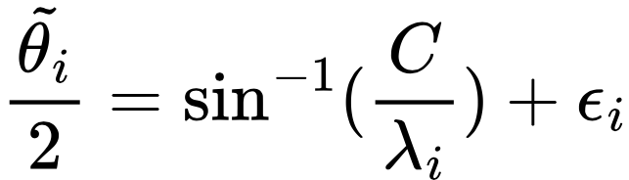
Imperfections

Slide 24
The algorithm

Slide 25
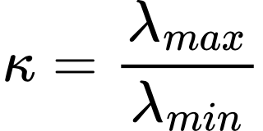
Kappa – κ The condition number

Slide 26
Thank you

